Slide 1
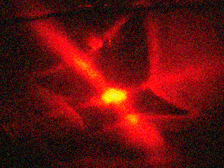
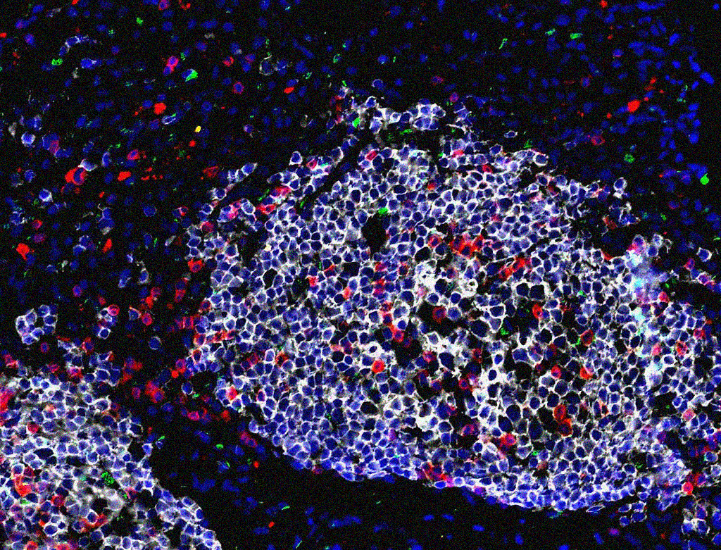
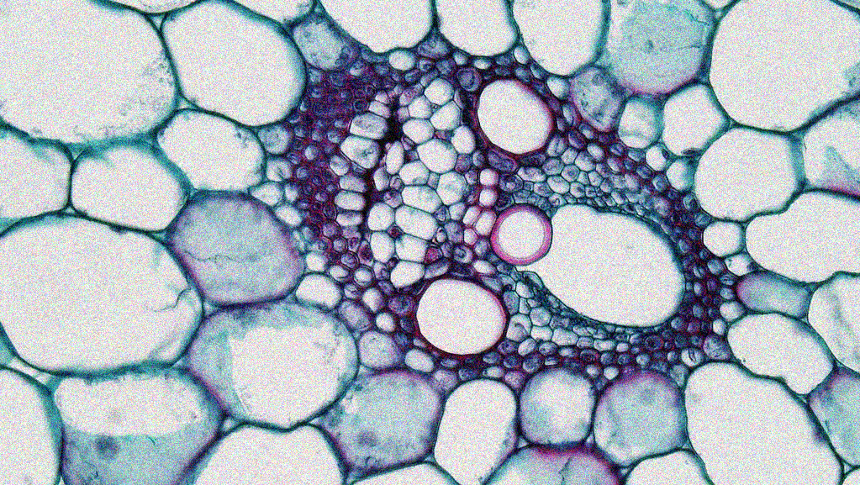
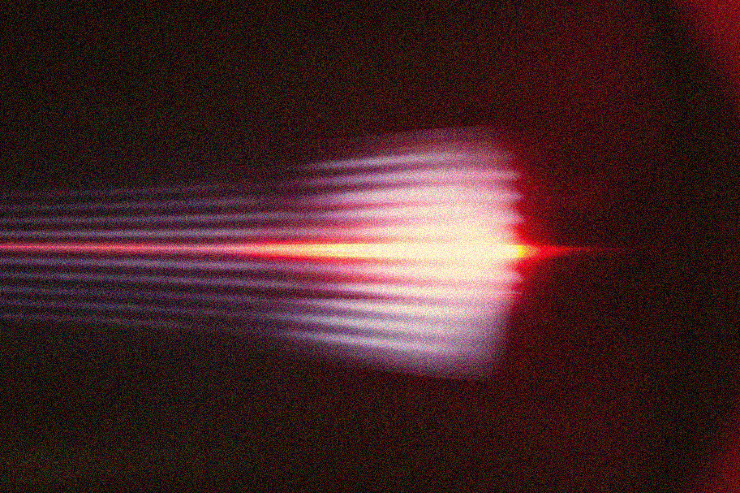
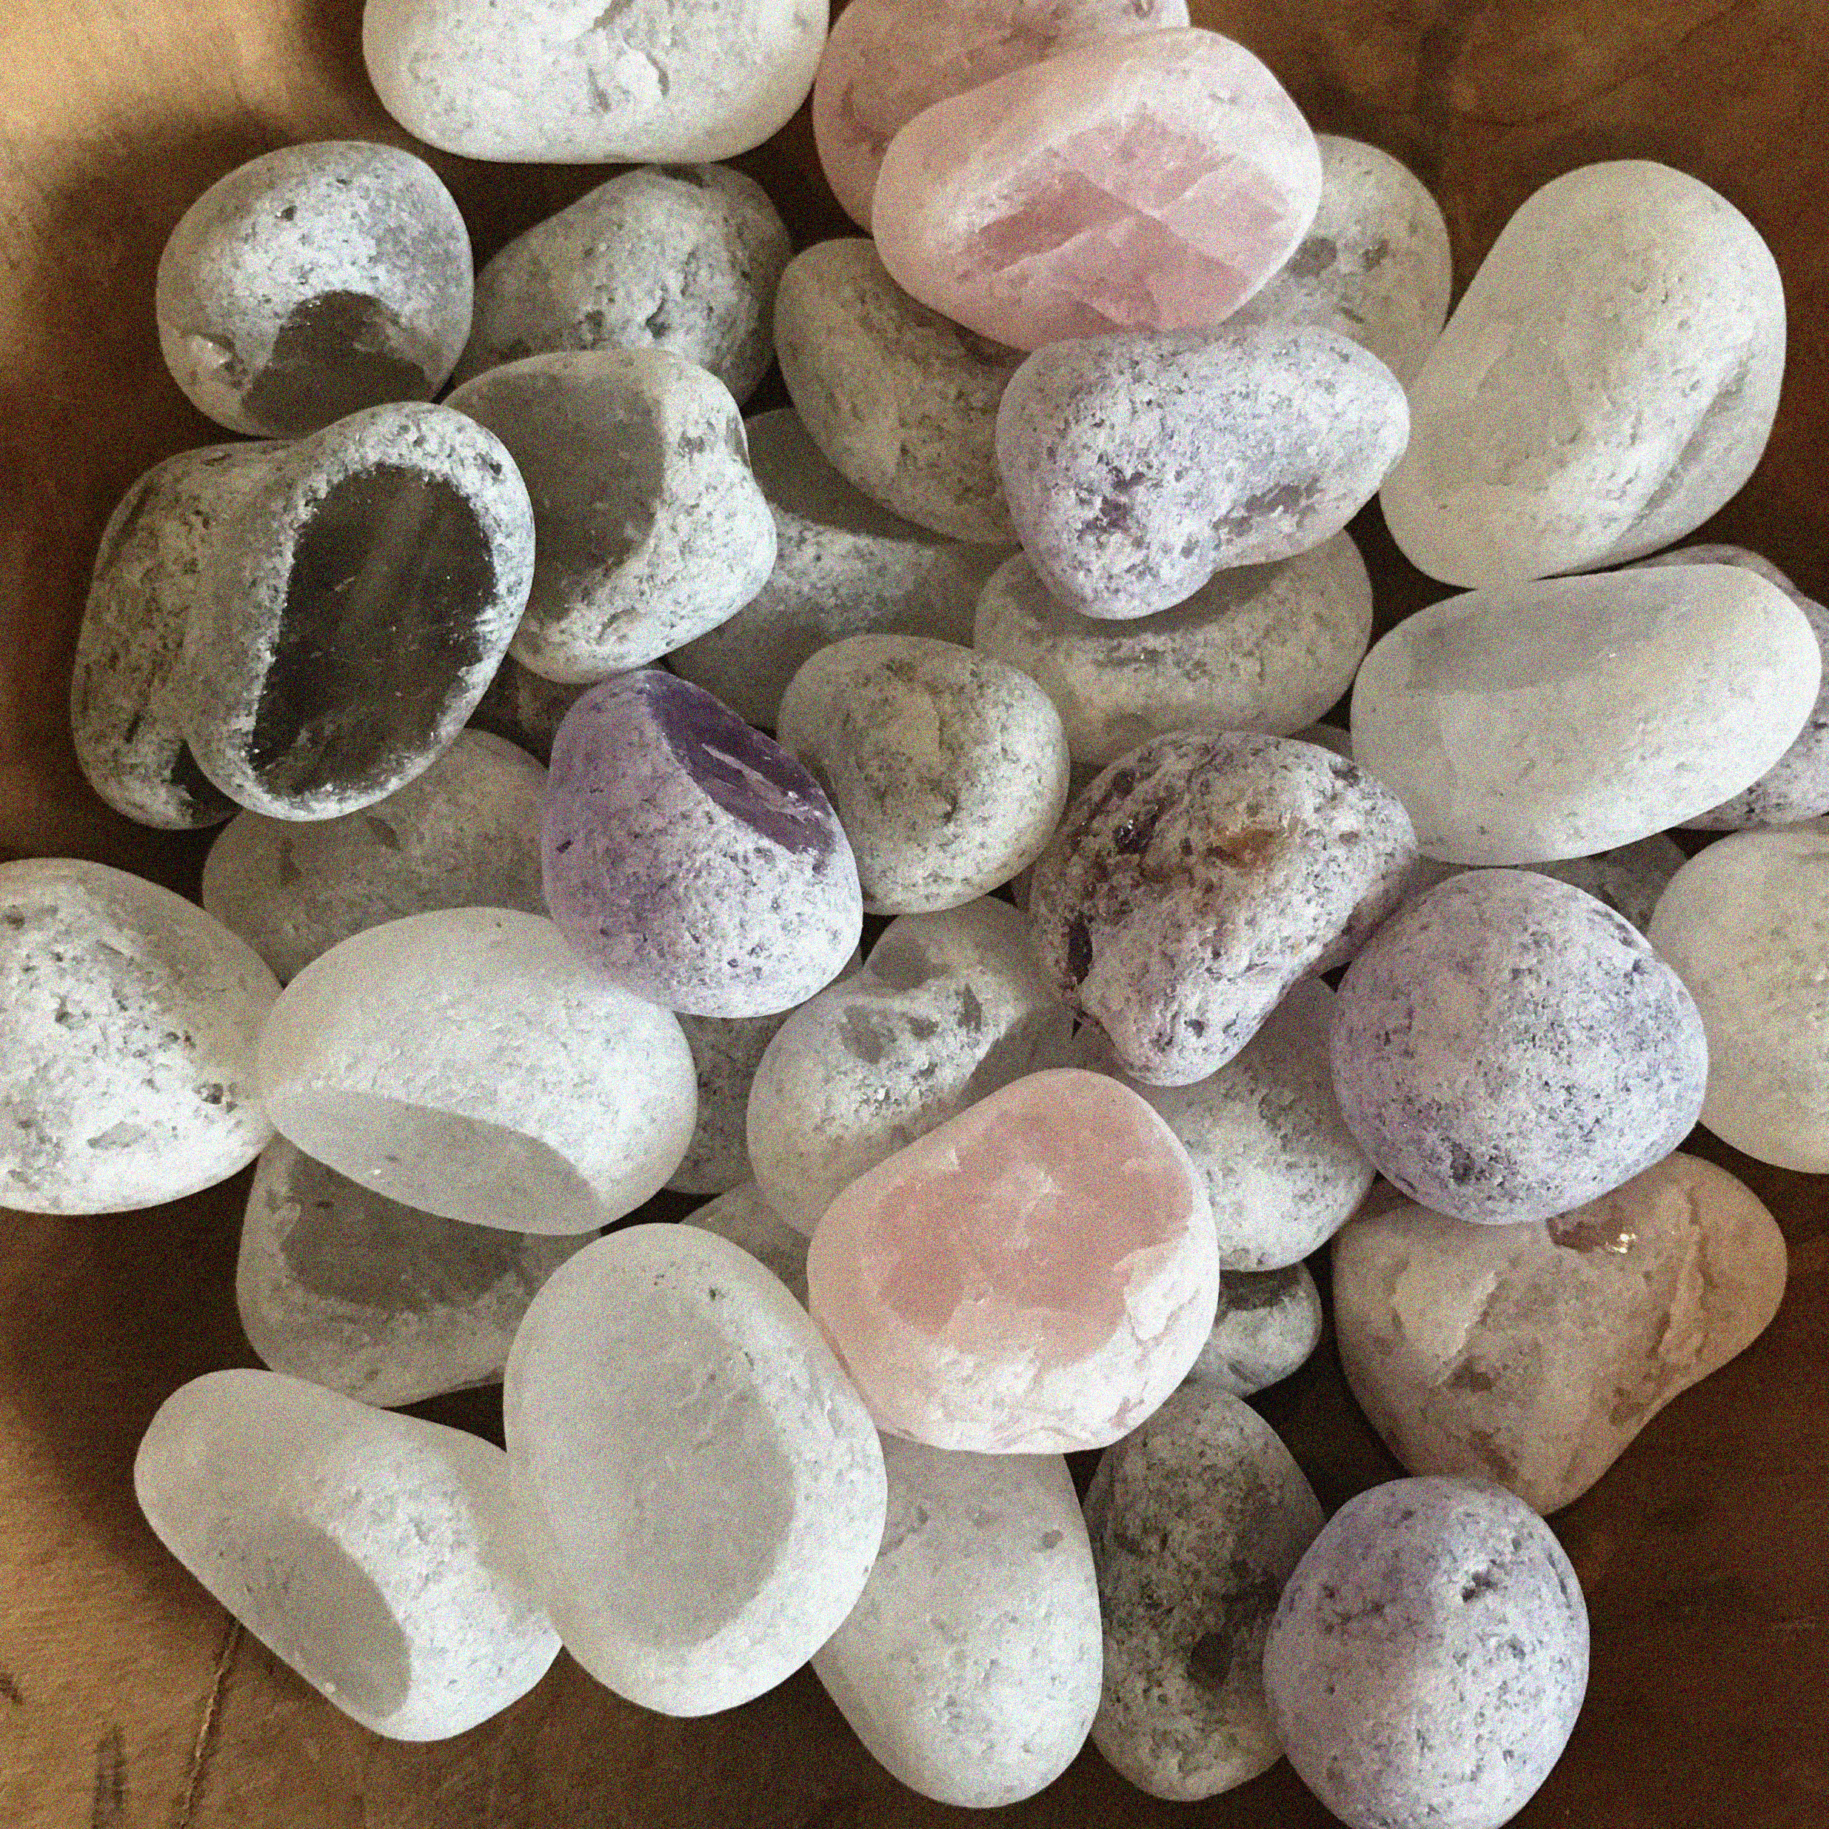

APP PHYSICS 157
COMPUTATIONAL ANALYSIS AND MODELLING
FEATURE EXTRACTION USING IMAGEJ
IMAGE AND VIDEO PROCESSING – MODULE 1
NINO PHILIP RAMONES | GITHUB
2020 – 05616
APRIL 21, 2023
This Photo by Unknown Author is licensed under CC BY-NC-ND
This Photo by Unknown Author is licensed under CC BY-SA-NC

Slide 2

APP PHYSICS 157
PROPERTIES AND APPLICATIONS OF THE 2D FFT
OBJECTIVES
Segment images using ImageJ and derive some noticeable features from the processed image
Compare how ImageJ segments and reports values from actual scales and measurements of some real life objects
KEY TAKEAWAYS
Thresholding is useful in image segmentation since it is the simplest way to separate blobs or cells of interest from the background
Setting a scale to your image is crucial in obtaining some measurements
SOME PITFALLS
Image must not be inverted after binarizing since ImageJ reads an error on the threshold values – this affects the ability of the application to clip grayscale values and eventually segmenting the image as it should

Slide 3
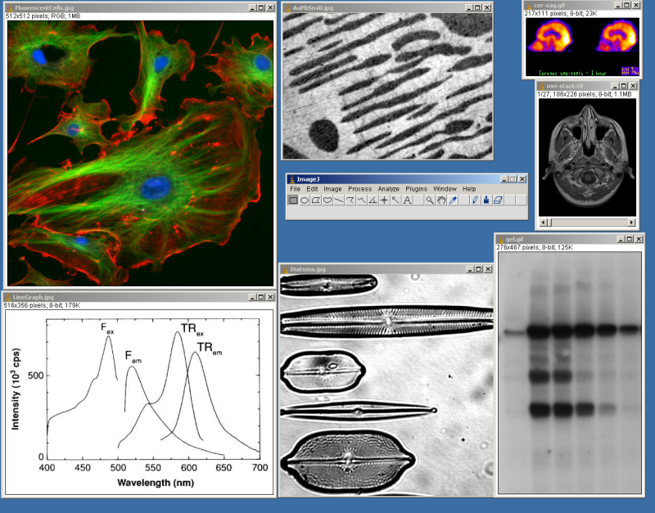
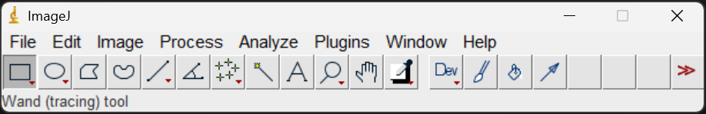
APP PHYSICS 157
FEATURE EXTRACTION USING IMAGEJ
IMAGEJ
Image Processing and Analysis in Java
ImageJ is a public domain image processing program developed at the National Institutes of Health for computational instrumentation. It is a Java-based scientific image processing software that can measure properties of objects using image segmentation techniques, which will be the focus of the next activities.
In this activity, ImageJ was used for image segmenting and analyze regions of interests as such. User-written plugins inherent to ImageJ has made it possible for the public to solve various image processing problems not limited to three-dimensional cell imaging and even blob analysis (ImageJ Documentation, n.d.)
Figure 1. Screenshot of the ImageJ from Wikipedia.
Figure 2. ImageJ interface as opened in Windows.

Slide 4
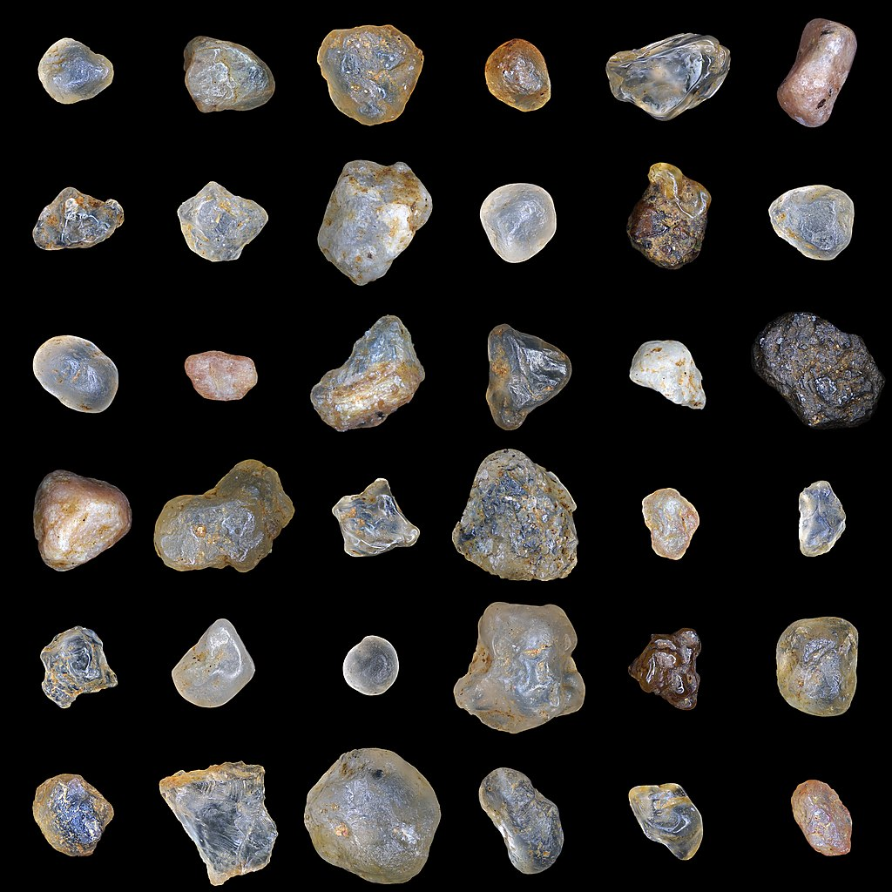
APP PHYSICS 157
FEATURE EXTRACTION USING IMAGEJ
SAMPLE FEATURE EXTRACTION
Basic blob detection and analysis of grains of sands
In this activity, we will consider segmenting the image of sand grains of varying shapes and sizes and draw some properties of individual grains using ImageJ.
It must be noted at first that to make physical measurements from digital images, a scale must be set that that can be used as reference. In this image, the sand grain with assumed known length or diameter was used as reference for values. Since the exact definition of sand varies, a range of sand particle diameter was taken – around 0.0625 mm as per the particle size set by geologists.
Figure 3. Sand grains of varying sizes. Image sourced from Wikipedia.

Slide 5
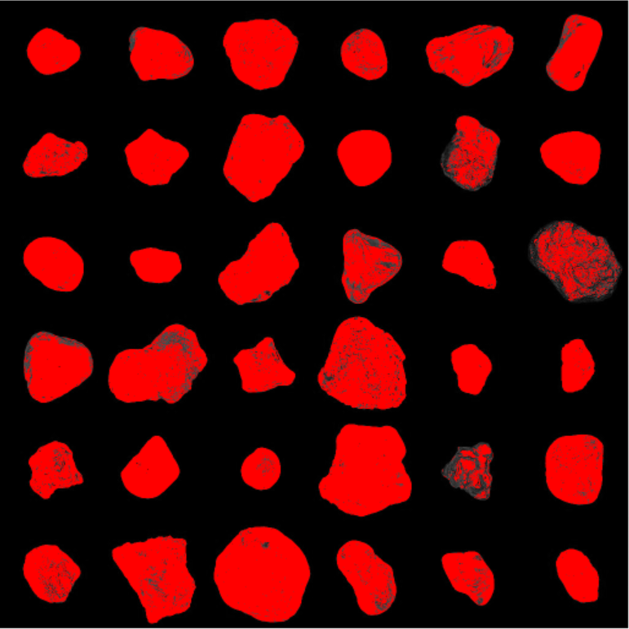
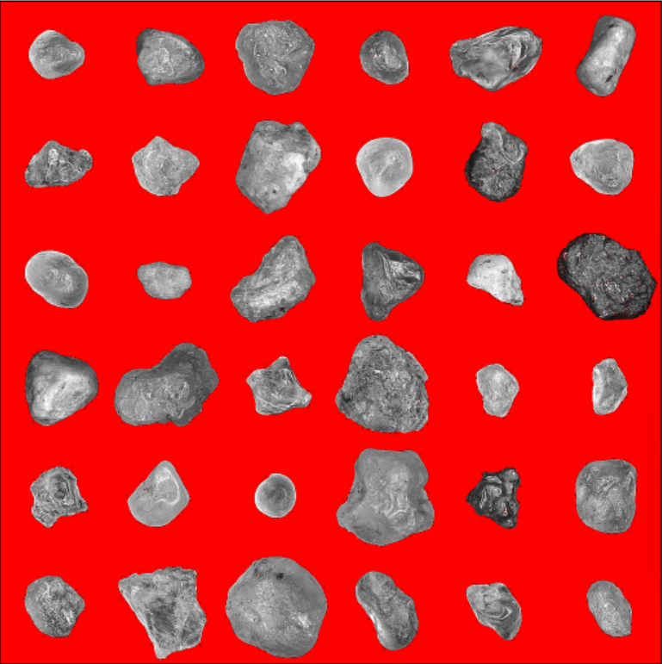

APP PHYSICS 157
FEATURE EXTRACTION USING IMAGEJ
SEGMENTATION BY THRESHOLDING
(a) Prior to threshold adjustment
(b) Adjusted threshold near peak values
(c) Threshold applied to sand image
Figure 4. Image segmentation by thresholding using ImageJ.
Prior to thresholding, the sand grains image was converted from RGB to 8-bit grayscale image. Converting the image to 8-bit is crucial so that we can segment our grains through thresholding. This can be seen in figures 4a and 4b where the grains are automatically segmented or separated from the background upon adjusting our threshold values. Basically, the grayscale makes the segmentation techniques much easier since a specific gray value will act as a cut-off, hence, threshold for our image!

Slide 6
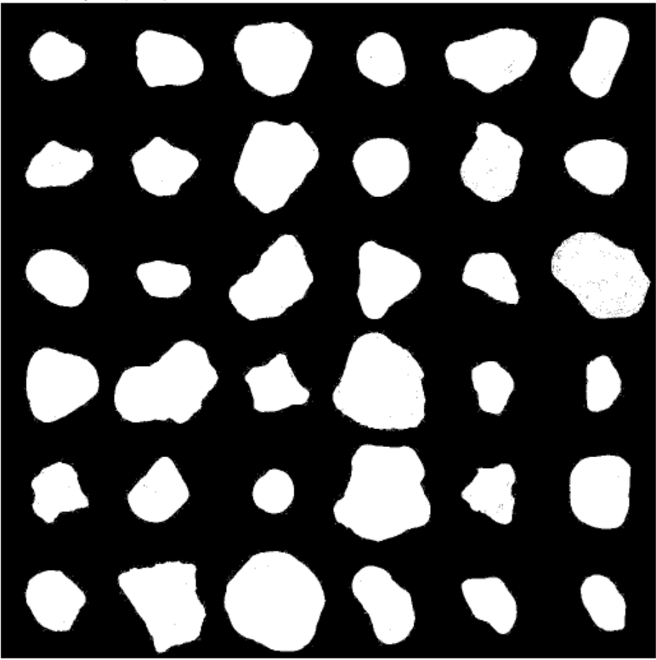
APP PHYSICS 157
FEATURE EXTRACTION USING IMAGEJ
BINARIZING THE IMAGE
After thresholding, we binarize the image. In principle, binarizing is the process of taking a grayscale image and converting it to black and white as it is. This reduces the information contained in the image since the 256 shades or values of gray has been reduced to two – black and white! This prepares ImageJ to measure some properties of the grains since the blobs or grains are now explicitly distinct from the background.
Figure 5. Binarized image of sand grains after thresholding.

Slide 7
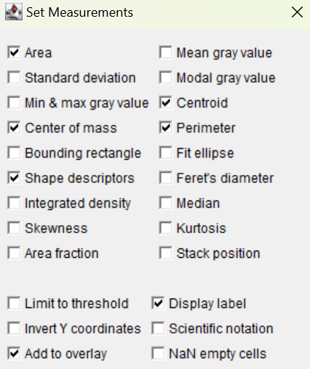
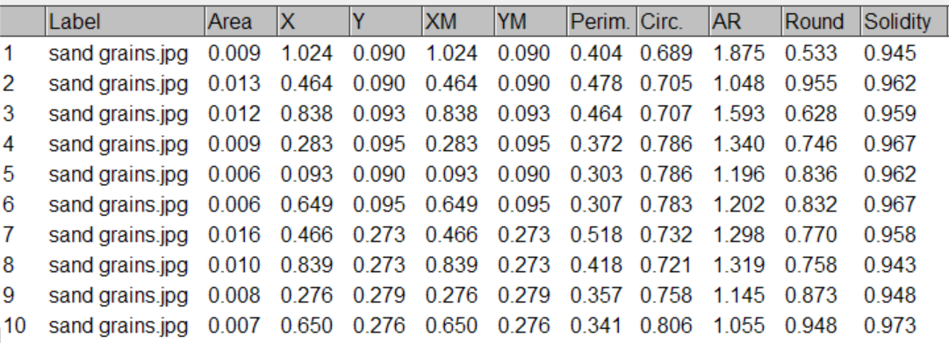
APP PHYSICS 157
FEATURE EXTRACTION USING IMAGEJ
SAND GRAIN MEASUREMENTS
Figure 7. Table of values for measurements generated.
From the set measurement options in ImageJ, the parameters of interest were chosen that will be extracted from the binarized image of our sand grains. This is why we have set a scale earlier since most of the measurements that will be returned were based on the set scaled diameter of the grain – 0.0625 mm as estimate or average.
Figure 6. Parameters to be measured from the grains.

Slide 8
APP PHYSICS 157
FEATURE EXTRACTION USING IMAGEJ
SAND GRAIN MEASUREMENTS
One of the interesting results observed is that ImageJ was able to quantify the number of sand grains in the image. This can be useful when one wants to count a somehow uncountable setup of objects on large scale – such as rice grains.
Other extracted features, from Figure 7, were the aspect ratio (AR), Roundness or inverse of aspect ratio, and solidity of grains, which is the ratio of the area and convex area.
Figure 8. Labelled blobs or sand grains after measurement in ImageJ.

Slide 9
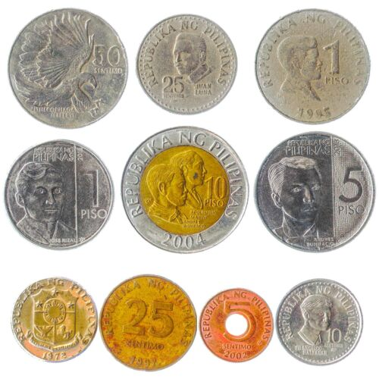
APP PHYSICS 157
FEATURE EXTRACTION USING IMAGEJ
ANALYSIS ON PHILIPPINE PESO COINS
(a) Original image from this site
(b) Binarized image after thresholding
(c) Identified coins through ImageJ
Figure 9. Images of interest for the Philippine peso coins analysis.
We also considered trying out other images – in this case is an image of the Philippine coins series – using ImageJ. Executing the same processes carried out in the sand grains, we obtain the result as shown in figure 9c. In this latter part of the activity, we validate if the ImageJ measurements were consistent with the actual measurement – diameter and area of coins.

Slide 10
APP PHYSICS 157
FEATURE EXTRACTION USING IMAGEJ
ANALYSIS ON PHILIPPINE PESO COINS
Coin number label | Coin denomination | ImageJ perimeter (mm) | ImageJ diameter (mm) | Actual diameter (mm) | Percent error
2 | Php 1 | 80.067 | 26.641 | 24.000 | 10.158
4 | Php 10 | 88.327 | 28.115 | 26.500 | 5.744
5 | Php 5 | 84.235 | 26.812 | 25.000 | 6.758
Table 1. Summary of some coin measurements derived upon segmentation using ImageJ.
Table 1 shows some of the coin measurements derived upon segmenting the coin image in ImageJ. The discrepancy in values between the experimental and actual diameters were minimal, which can be attributed to how ImageJ segments and measures the coins after thresholding. It can also be observed from figure 9c that coin number 7 were labelled on two coins. This is because the spacing between those two coins – the 25 cents and 10 cents – were minimal that ImageJ treated them as one blob or coin. This is where morphological operations come into place, which is yet outside the scope of this activity! Nonetheless, the measurements ImageJ reported, and the actual values were still worth comparing to as some measurements can be carried out using applications like this. Interesting!

Slide 11
APP PHYSICS 157
PROPERTIES AND APPLICATIONS OF THE 2D FFT
REFLECTION
I find the activity generally fun since it is somehow a breather from the recent coding activities done in the course. I find ImageJ convenient and straightforward to use since the interface was generally intuitive. Overall, I would give myself a score of 110/100 !
REFERENCES | GITHUB
M. Soriano, Applied Physics 157 – Feature Extraction, 2023.
Documentation_ (nih.gov)
ImageJ User Guide - IJ 1.46r | Analyze Menu (nih.gov)
Coins of the Philippine peso - Wikipedia

